Slide 1
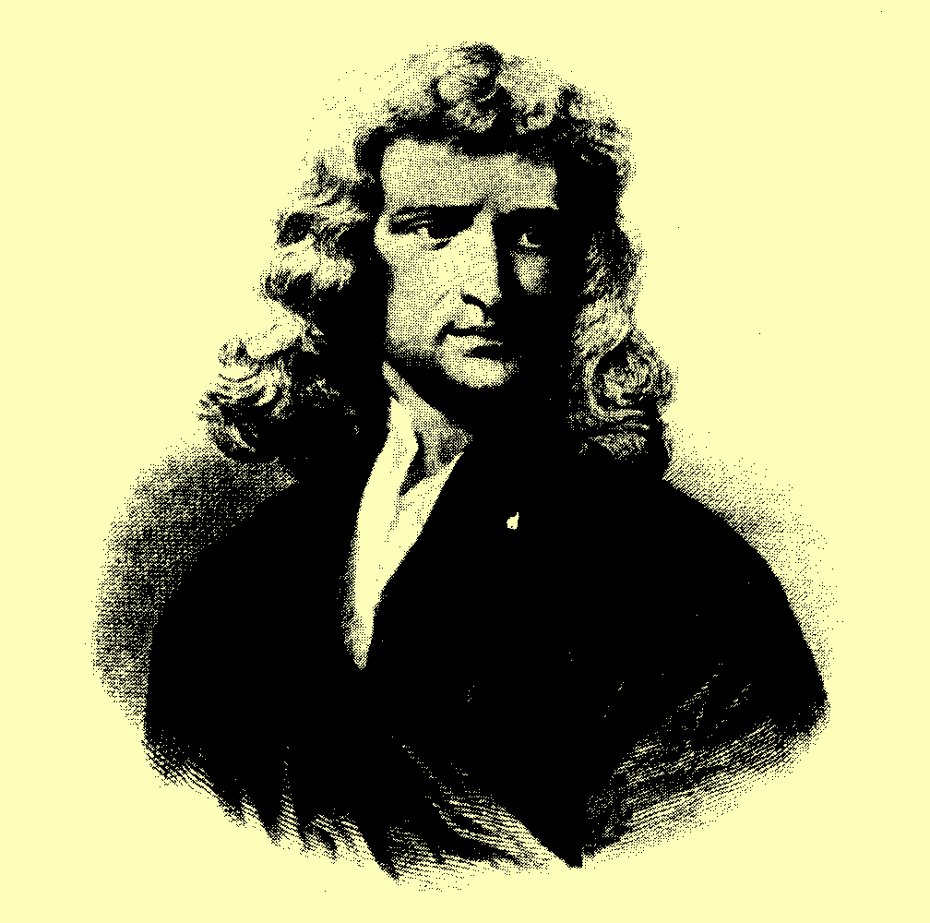
S I R I S A A C N E WTON
(1647 - 1727)

Slide 2
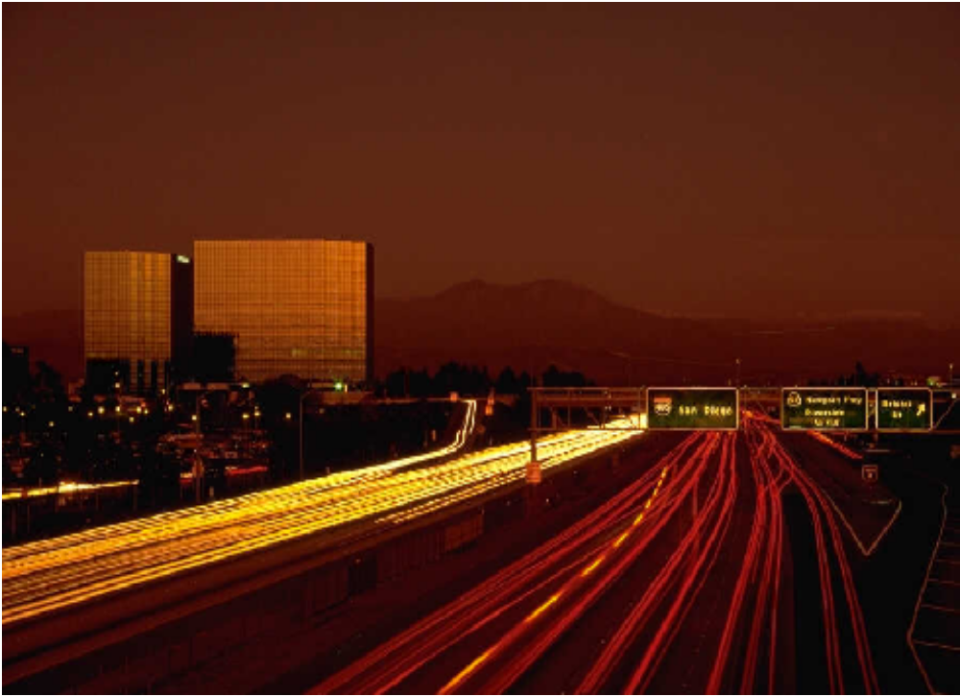
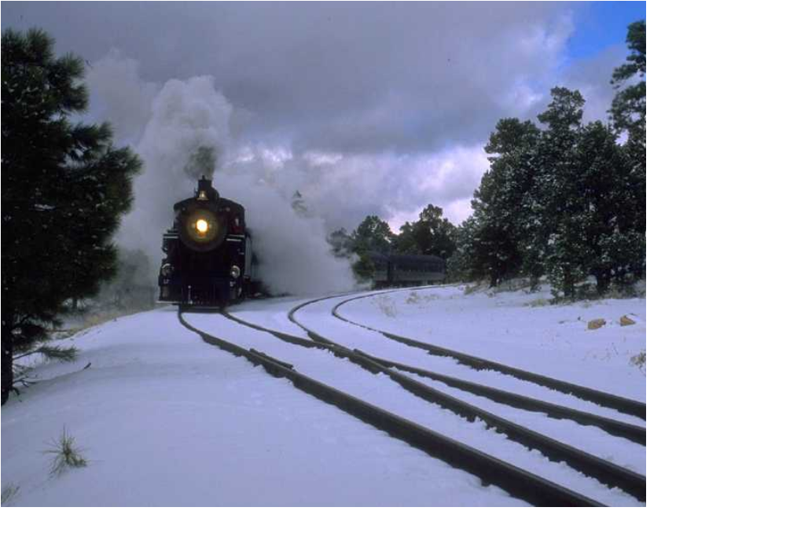
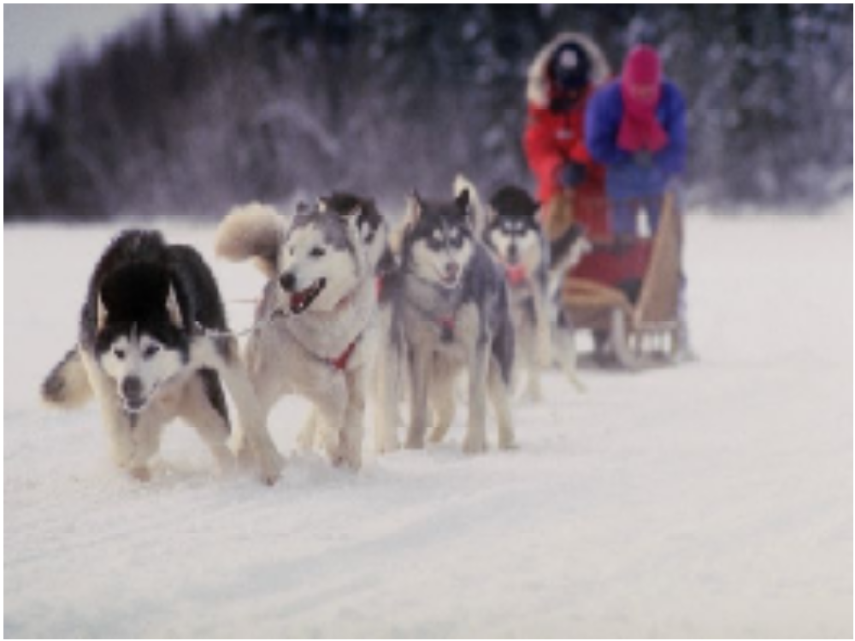

Slide 3
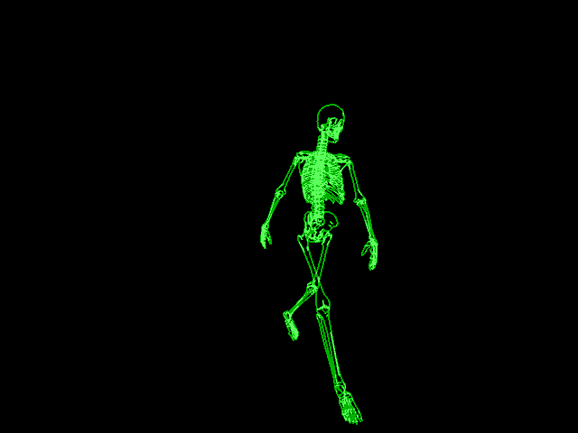

Slide 4
(1686)
Philosophiae Naturalis
Principia Mathematica
In this work, he proposed three “laws” of motion:

Slide 5
NEWTON’S FIRST LAW :
“Every body continues in a state of rest or uniform motion in a straight line unless impressed forces
act upon it.”

Slide 6
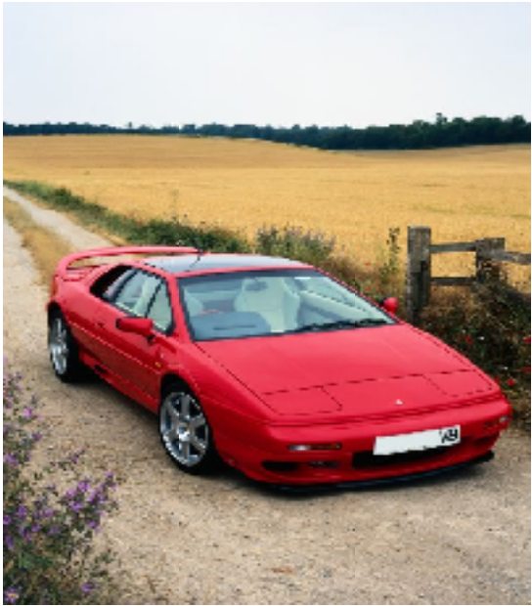
parked up
NEWTON’S FIRST LAW :
“Every body continues in a state of rest or
uniform motion in a straight line unless
impressed forces act upon it.”

Slide 7

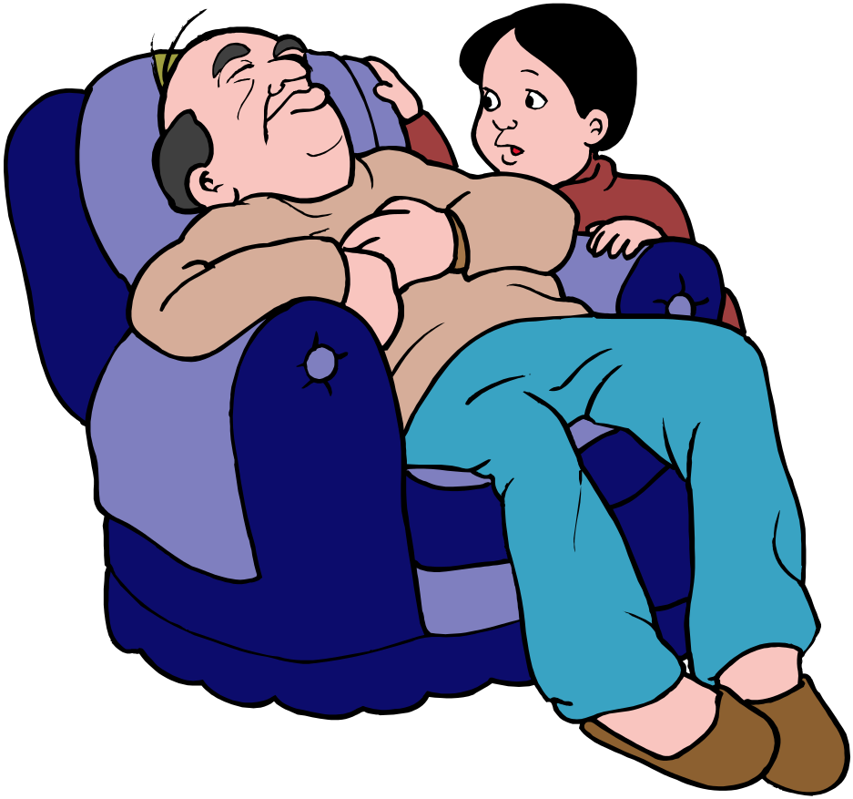
AAAAAAAH
STATE OF REST
UNLESS ……. !

Slide 8





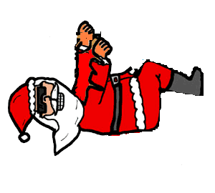
NEWTON’s FIRST LAW
… constant velocity, unless ……..
YOU UNDERSTAND WHAT I AM SAYING

Slide 9

NEWTON’s FIRST LAW INTRODUCES THE IDEA OF INERTIA
THE RELUCTANCE OF A BODY AT REST TO MOVE
(OR OF A MOVING BODY TO CHANGE ITS STATE OF MOTION)
MASS
THE PRACTICAL MEASURE OF INERTIA IS

Slide 10

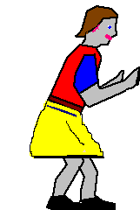
The greater the mass of a body, the greater its INERTIA
Make me

Slide 11
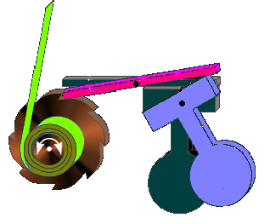
CAR SEAT
BELT
locking rod
pivots
seat belt
Car stops but inertia carries pendulum forward
ratchet wheel
Direction of motion

Slide 12
WHEN FORCES ARE BALANCED
OBJECTS AT REST, STAY AT REST
OBJECTS IN MOTION, STAY IN MOTION
[SAME SPEED & DIRECTION]

Slide 13
A body is in a state of equilibrium if the forces acting on it are in balance
8 N
8 N
2 forces balanced
8N
8N
120⁰
120⁰
120⁰
3 forces balanced
8N

Slide 14
THERE ARE TWO CONDITIONS FOR A BODY TO BE IN EQUILIBRIUM:
THE SUM OF THE FORCES IN
ANY DIRECTION IS ZERO
THE SUM OF THE MOMENTS
ABOUT ANY POINT IS ZERO

Slide 15


CAN YOU EXPLAIN WHAT HAPPENS BELOW?

